Slide 1
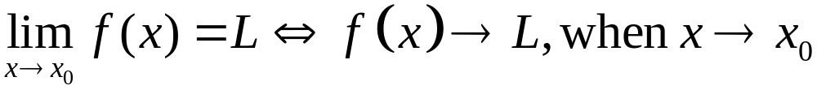
Limits of Multi-Variable Functions

Slide 2
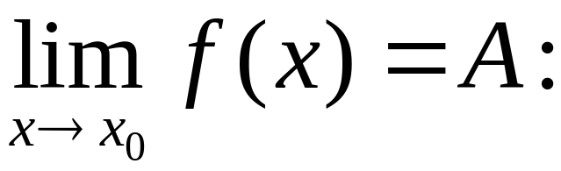
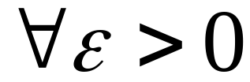
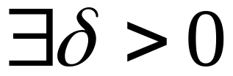
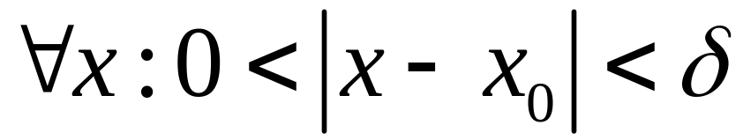
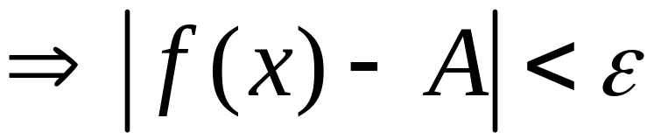
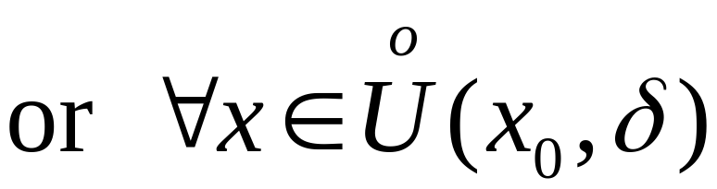
Recall

Slide 3
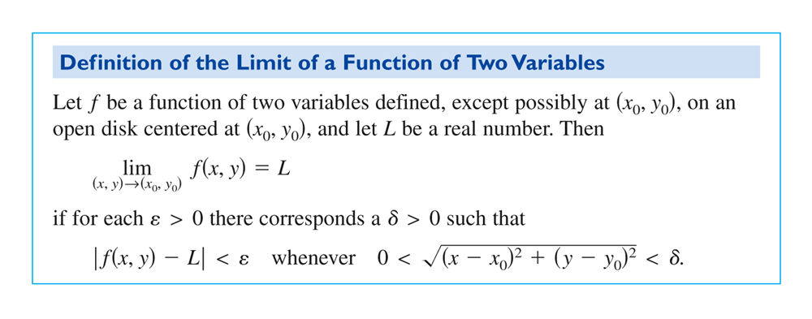
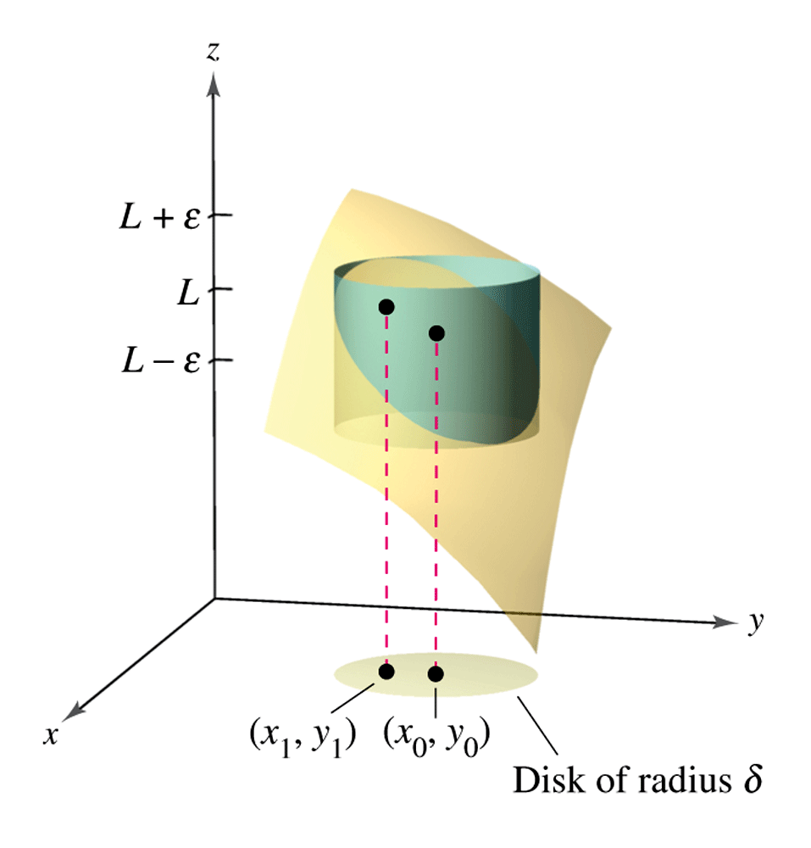

Slide 4
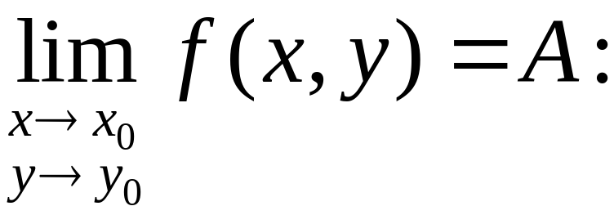
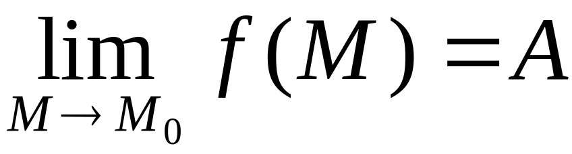
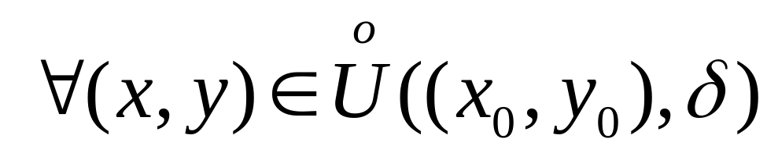
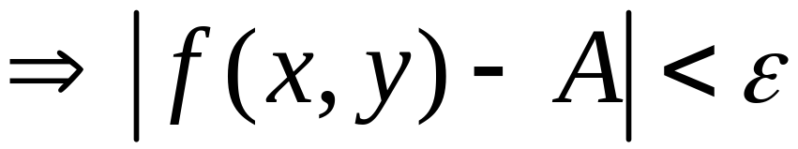
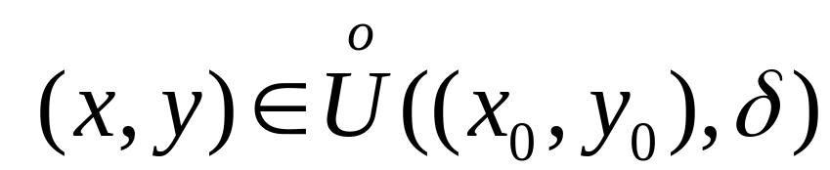
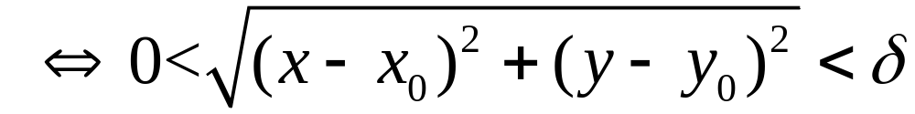
Limits of functions of two variables

Slide 5
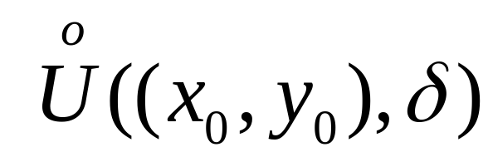
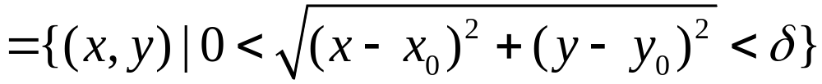




Slide 6
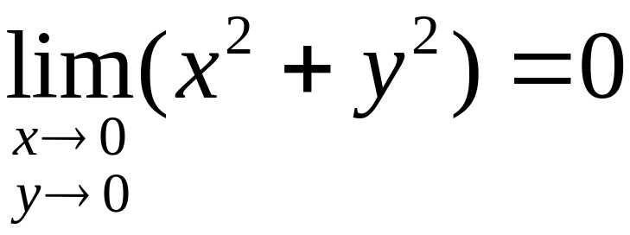
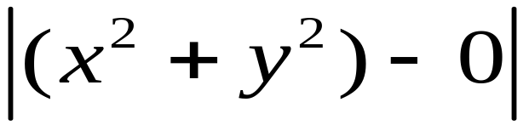
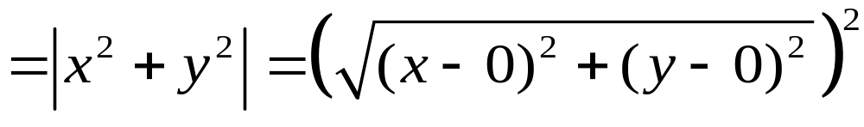

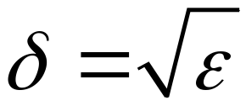
Example
希望
取

Slide 7

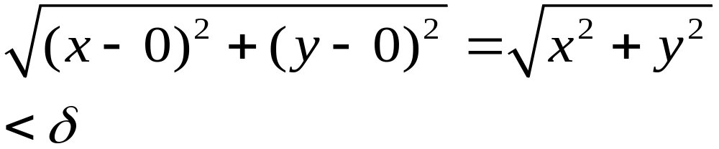
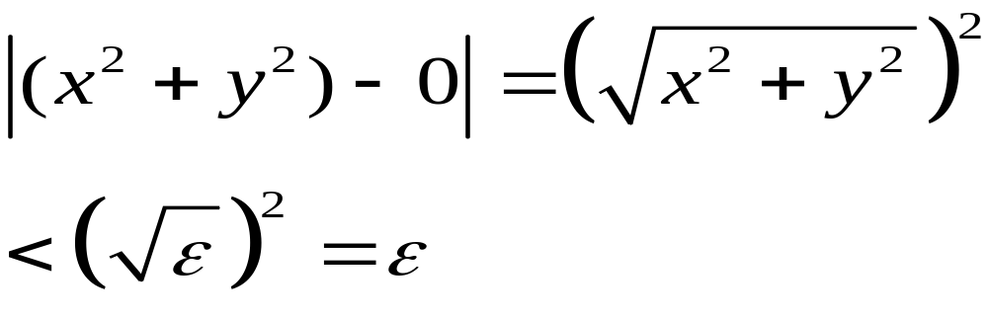
For any , take
Then, when
we have
So

Slide 8
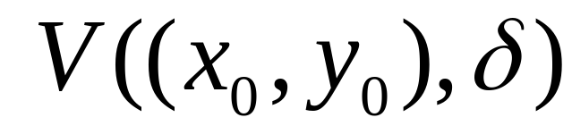
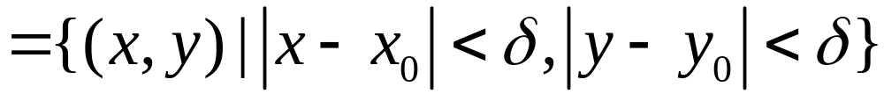
Another type of neighborhood

Slide 9
Equivalence

Slide 10
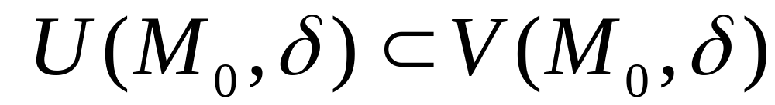
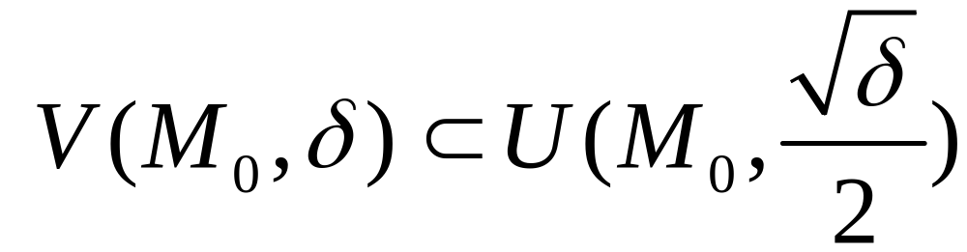
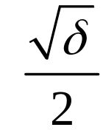
The equivalence

Slide 11

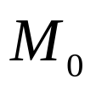
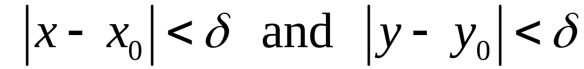
Limit using square neighborhood

Slide 12
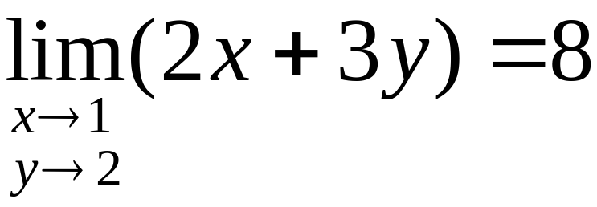
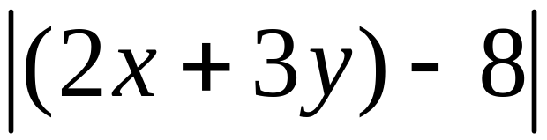
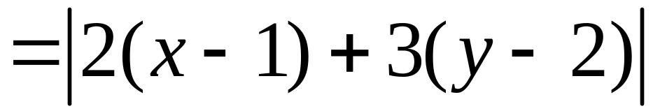
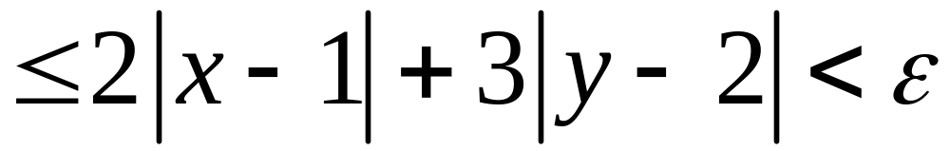
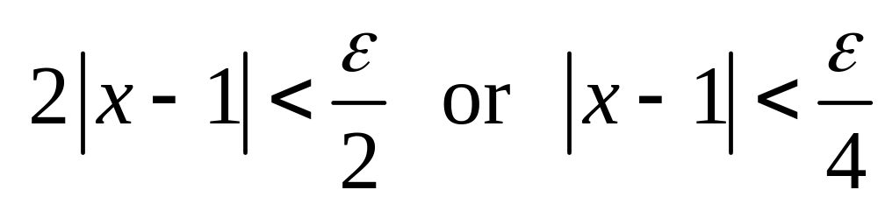
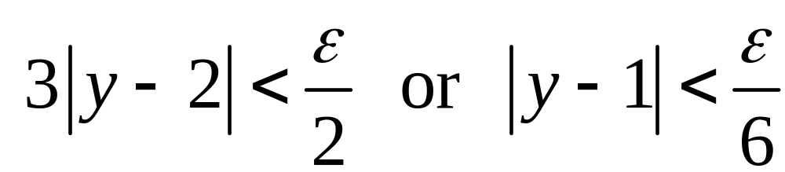
Example
If
then

Slide 13
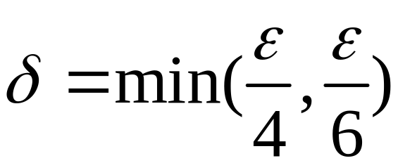
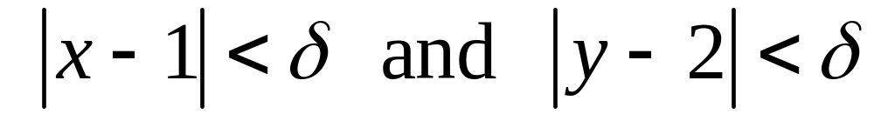
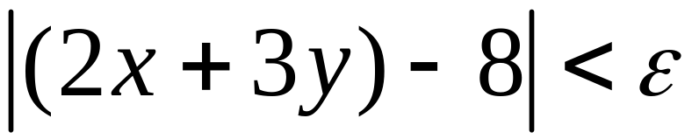
Let
when
We have
so

Slide 14
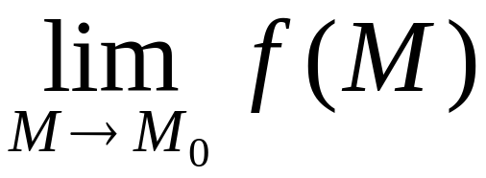
M(x, y) approaches M₀ in any way,
f(M) approaches A
If M(x, y) approaches M₀ in two different ways, f(M) approaches different numbers then
Does not exist

Slide 15
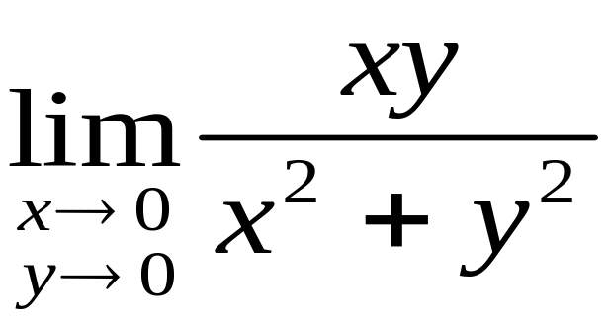


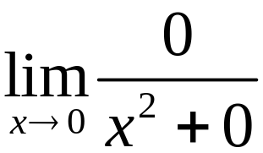
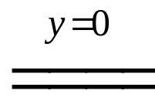
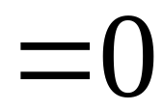
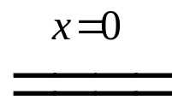
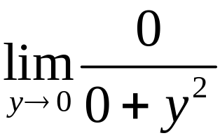
Show that
Does not exist
Pf.
Let M(x, y) approaches O(0,0) along the x-axis
Along the y-axis

Slide 16
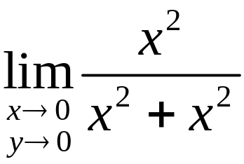
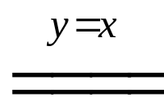
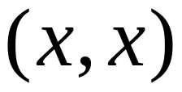
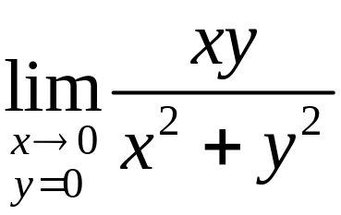


Let M(x, y) approaches O(0,0) along the line y = x
So,
does NOT exist.

Slide 17








Example:
Does not exist?
Pf.
M(x, y) approaches O(0,0) along any line y = kx

Slide 18









However
No！
When M(x, y) approaches O(0,0) along the parabola y = x²
does NOT exist

Slide 19



Slide 20



Iterative limits

Slide 21




In general
For instance
but
Does not exist

Slide 22



Theorem
If exists
and both and
exist
then

Slide 23




Notice
exists
exists
Example
but
does Not exist

Slide 24




Notice
exists
exists
Example
By Squeeze Thm,
but
does Not exist

Slide 25


Recall
f(x) is continuous at x₀

Slide 26


f(x, y) is continuous at (x₀, y₀)

Slide 27



Slide 28






Example
is continuous at (0,0) ?
Solution
Let
Along different lines, the limit is different, so no limit
Not continuous at (0,0)

Slide 29






Elementary functions of several variables are continuous on their domains
For example
are continuous on
is continuous on

Slide 30


Example
is continuous at each point (x, y) where

Slide 31
Properties of continuous functions over closed and bounded (compact set 紧集) set
Extreme Value Theorem
Properties of continuous functions over closed , bounded, connected set (bounded closed region)
Intermediate Value Theorem

Slide 32



Example
Solution
Since the function is continuous at (1,2)

Slide 33





Example
Solution

Slide 34







证明极限存在常用的基本方法
Squeeze Theorem （夹挤定理）
Example:
So,

Slide 35



Squeeze Theorem
Example:
So,

Slide 36


（II）Rationalization (有理化)
Example:

Slide 37



（III) 变量代换
Example:
Let

Slide 38





（IV) Asymptotic function (等价无穷小)
Example:

Slide 39





（V) Polar coordinate (极座标变换)
Example:
（因为 ）
注意
这里的
要想著与 有关，不能写

Slide 40



（V) Polar coordinate (极座标变换)
We have
does not exist.
不能这么做！！！
因为把 当成与
无关，相当于只考虑
方式趋近0

Slide 41
Example:
Does not exist?
Pf.
M(x, y) approaches O(0,0) along any line y = kx

Slide 42
However
No！
When M(x, y) approaches O(0,0) along the parabola y = x²
does NOT exist

Slide 43



Exercise:
find the following limits if exist.
(a)
(b)
(c)

